Slide 2
Types of testing
Functional testing: Testing the code
Non-functional testing: lagging, scalability( can 2 million users use the software at the same time?)

Slide 3
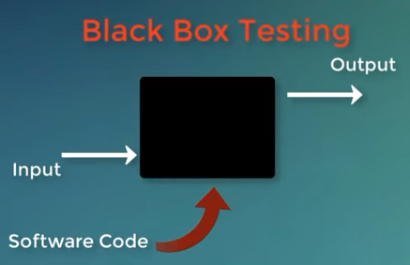
Testing techniques
Black box testing :
White box testing: check actual code

Slide 4
Level of testing
Unit testing (class testing )
Integration testing (combine different classes)
System testing (how it interact with other software)

Slide 5
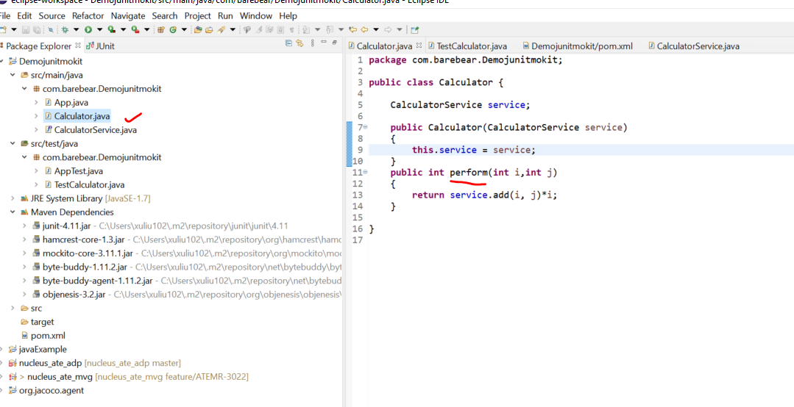
Create java script under main/java

Slide 6
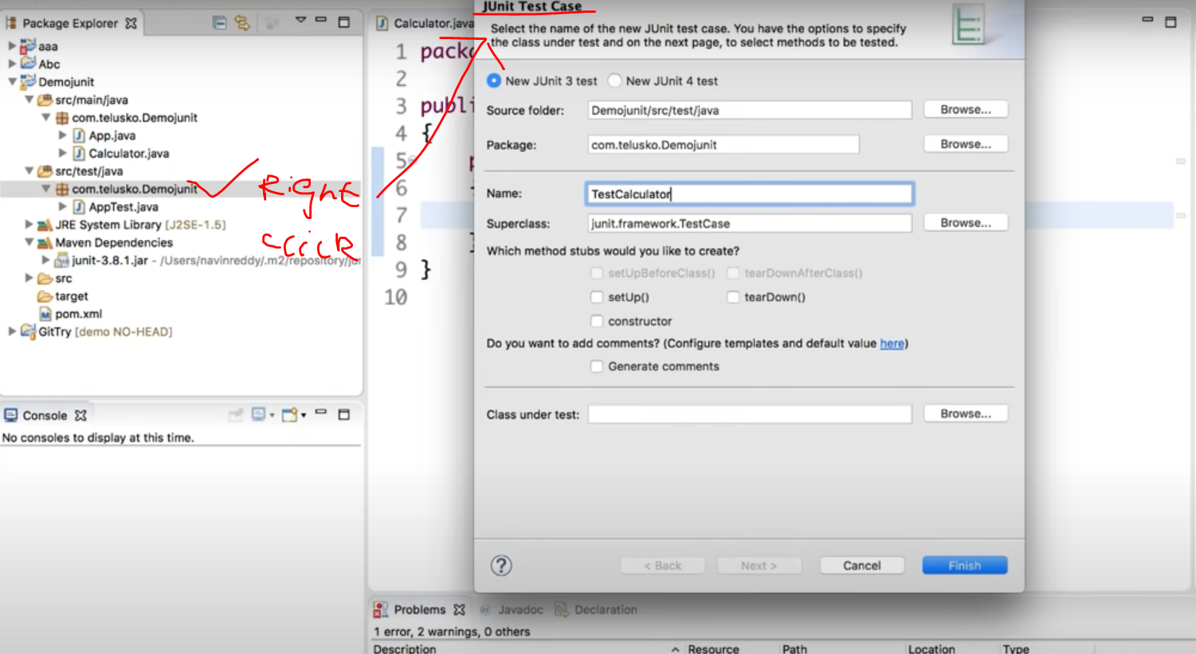
Create testcase (right click package name and create testcase)

Slide 7
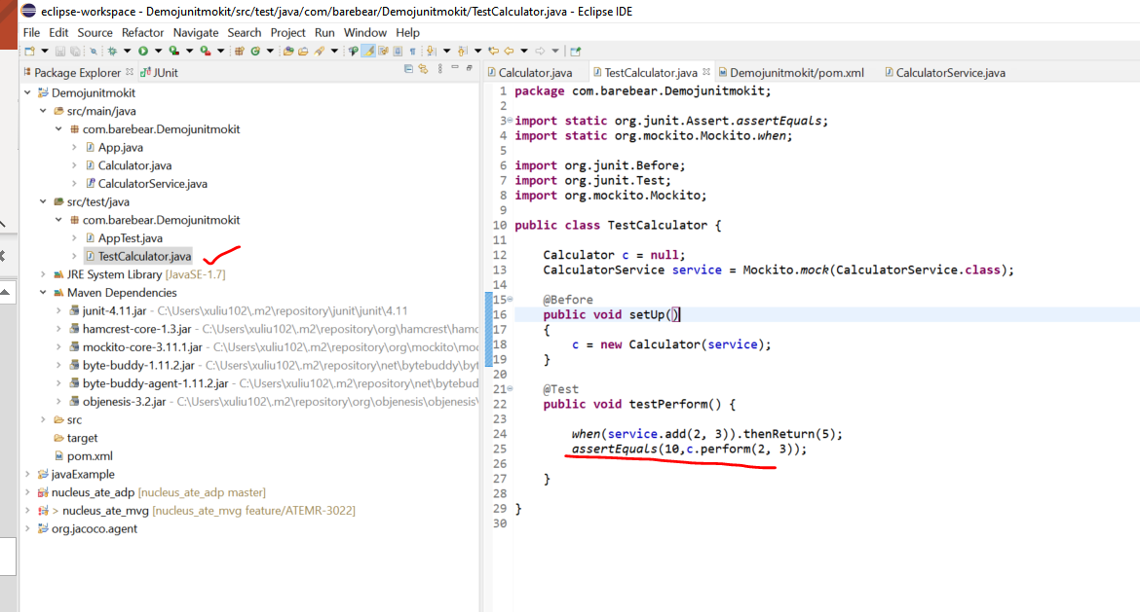
Update testcase

Slide 8
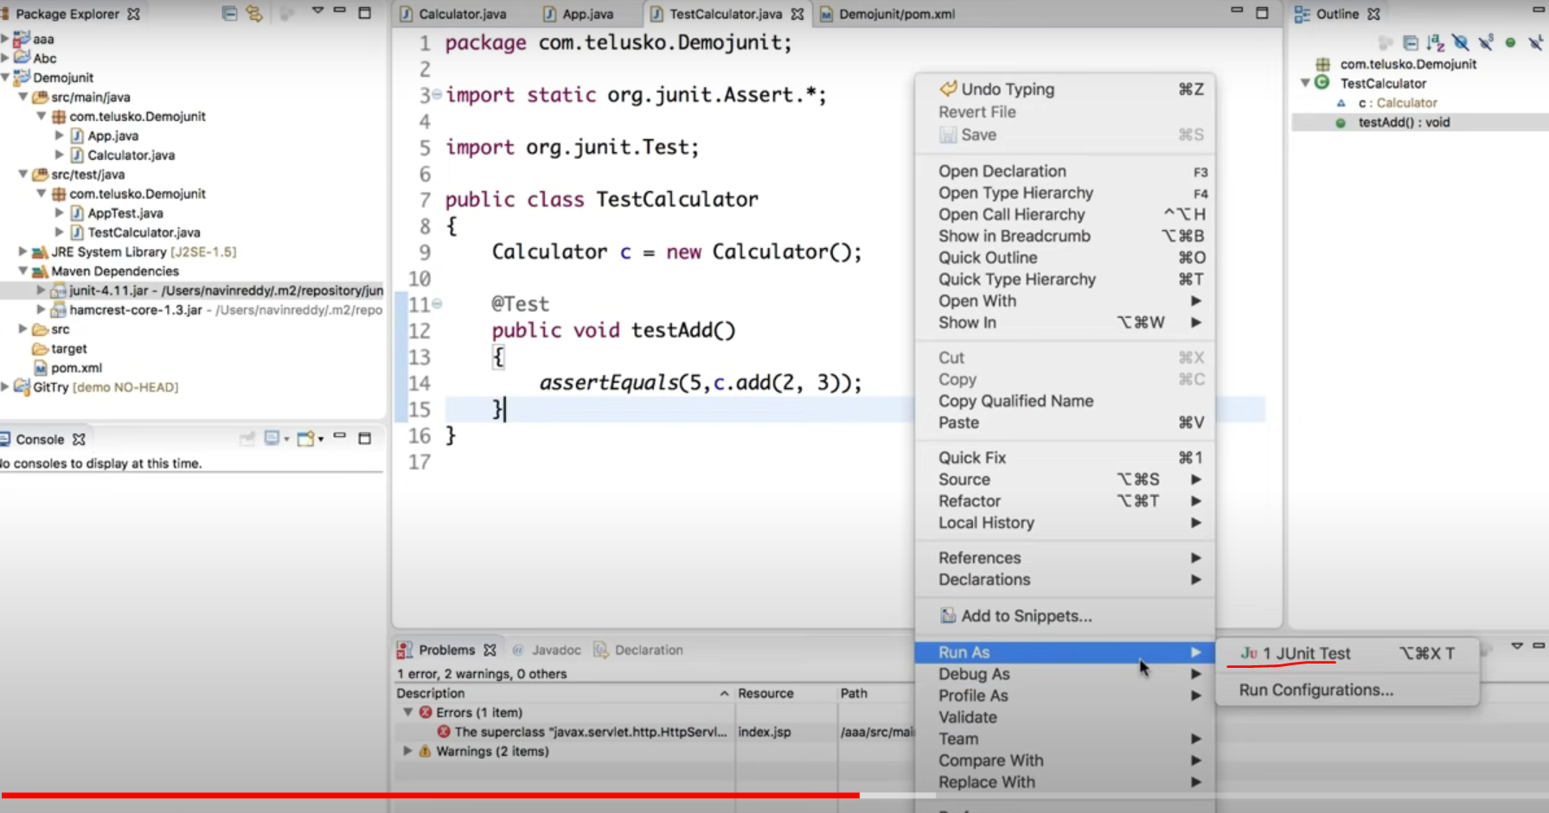
To test it
Right click “Run As”->”1 Junit Test”

Slide 9
Mockito
Application -> server
Mockito is to simulate the server so that we only need to worry about the application testing (no need to test the server since server supplier eg, Google already done a through testing of it)

Slide 10
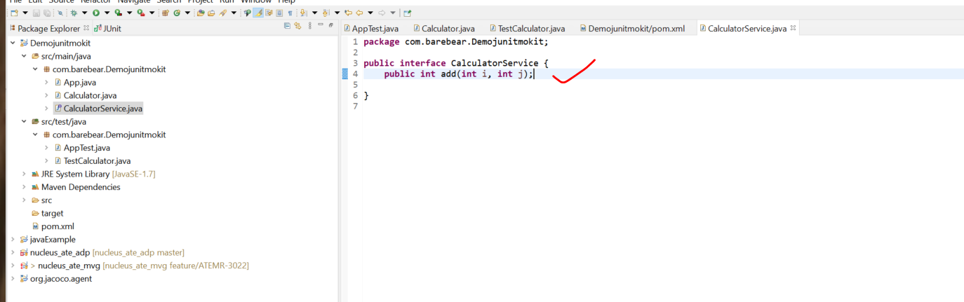
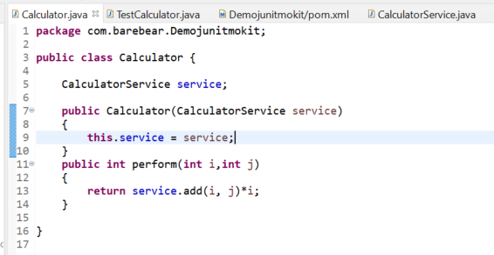
Mimic server
Java call the server to complete the task

Slide 11
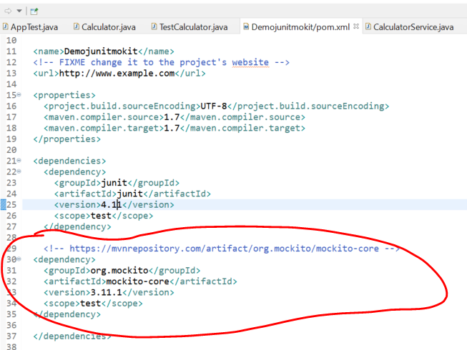
Add Mockito dependency

Slide 12
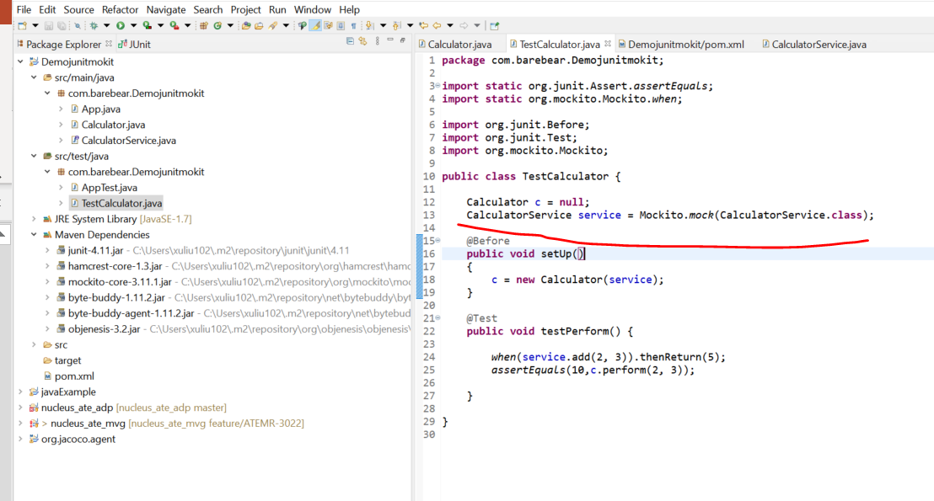
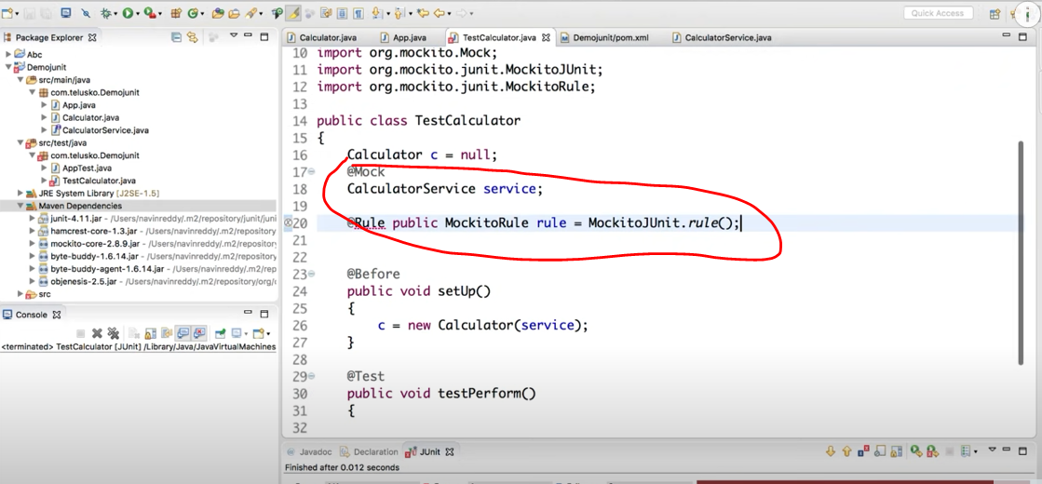
Update Mockito in java test case
OR

Slide 13
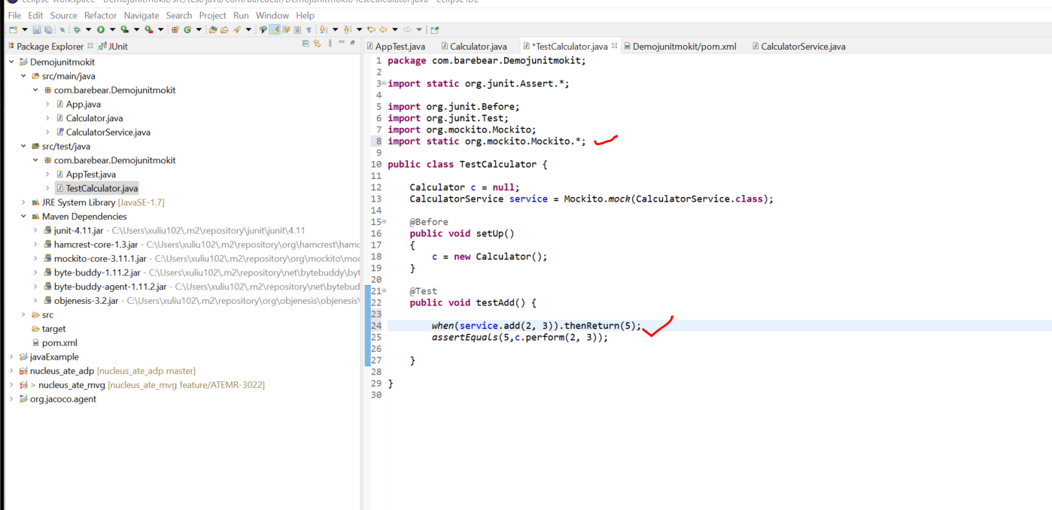
Simulate the server execution

Slide 14
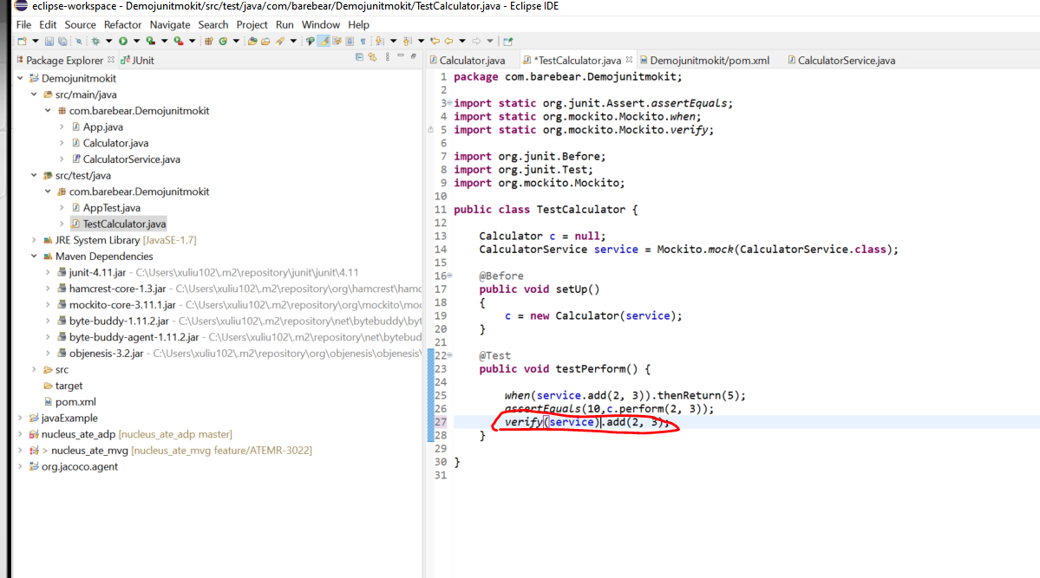
Verify really calling the server

